Slide 1

50 / 50
George Matevosyants

Slide 2
Outline
Data Overview
Exploratory Data Analysis
Feature Selection
Data Modeling
Results / Improvements
Appendix – supplemental material (plots, algorithms used)

Slide 3
Data Overview
Data Summary:
Current Population Survey (CPS) is the government data source that contains information regarding employment within the US and was provided as the main data source.
Data from years 94 – 95 was combined with Annual Social and Economic (ASEC) Supplement to expand the data set and bring in additional information.
Final dataset is a conglomerate of 4 tables: CPS, House, Family and Personal tables.
Problem Statement:
Identify characteristics that are associated with a person making more or less than $50,000 per year.
Methods:
Data Exploration – analyze the data to get an intuition for which columns provide information.
Feature Selection – explore correlations between columns and exclude any columns that provide similar information.
Data Modeling – build and tune the model that classifies each row as >$50k or <$50k.
Feature Importance – inspect which columns are most important to model’s decision making.
Results:
Characteristics shown below have the biggest impact on determining if a person makes over $50,000 / year.
Capital Gains
Dividends from Stocks
Wage per Hour
Age
Capital Losses
Weeks Worked in Year
Tax Filter Status
Education
Detailed Household and Family Stats
Industry Code
Class of Worker
Occupation Code

Slide 4
Exploratory Data Analysis

Slide 5
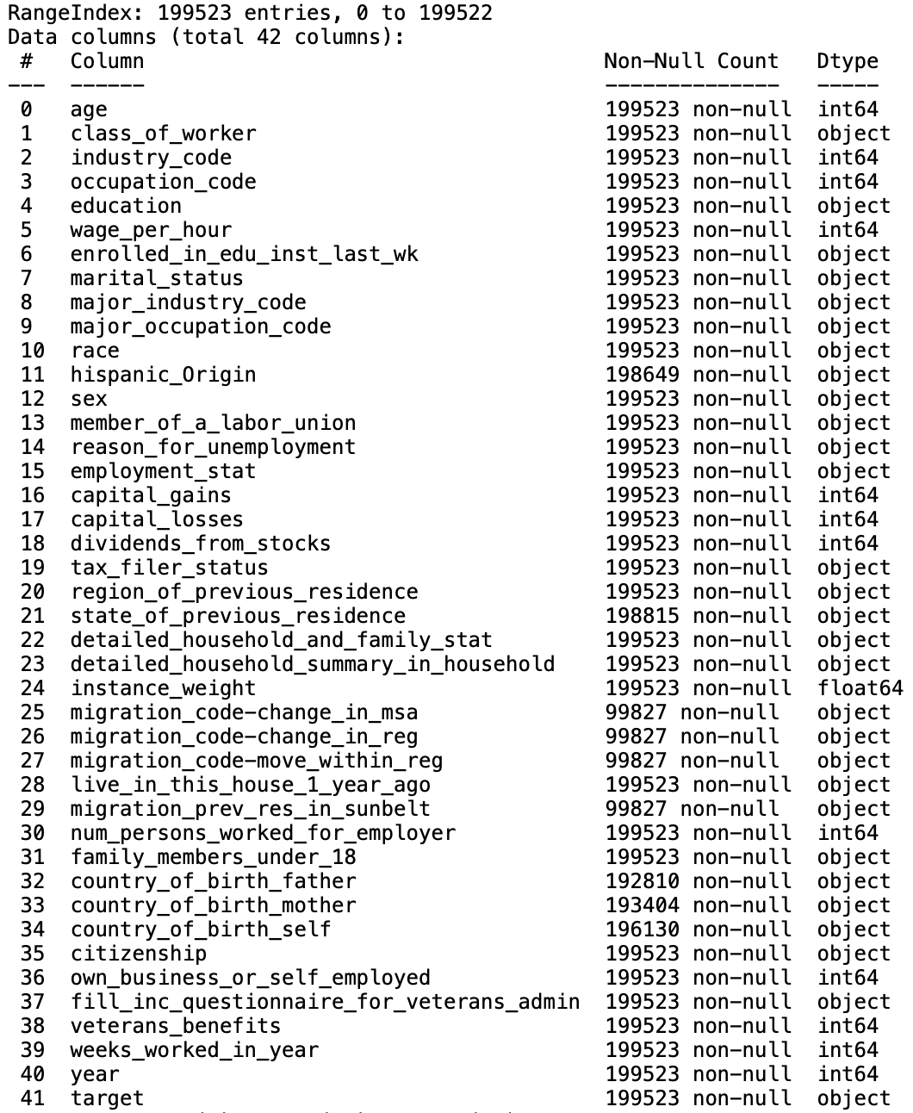
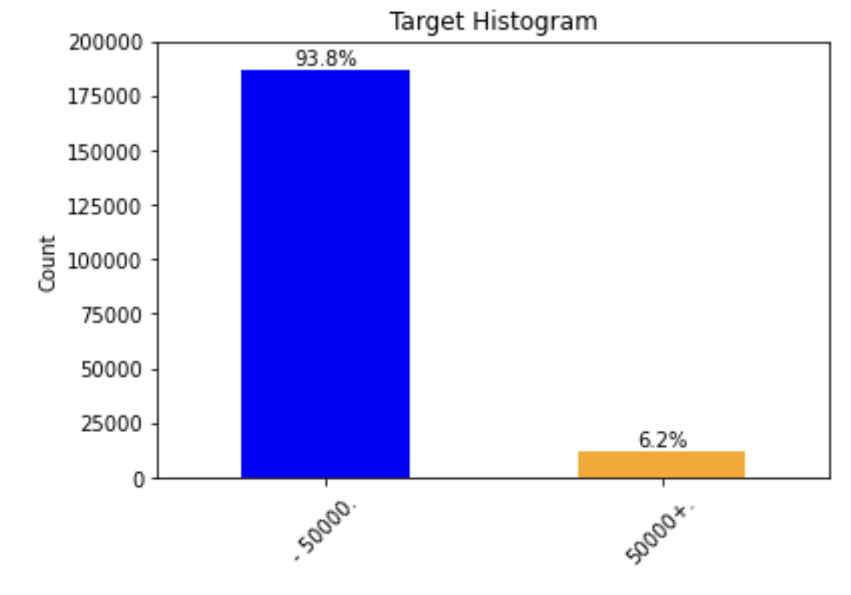
Data Summary
Data Structure:
Data file is split into training and testing sets. Provided with 2 separate files.
Training set contains 200k records and test set has 100k.
Columns highlighted in red are missing majority of the values and are excluded from the analysis.
Target is extremely imbalanced, 93.8% of records make less than $50k. If model accuracy exceed 93.8% then model was able to learn something.
Glossary:
Feature – column used to make predictions
Continuous Features – numerical columns
Categorical Features – text and category columns
Target – what we are trying to predict
Negative Class (0) – people making < $50k / year
Positive Class (1) – people making > $50k / year

Slide 6
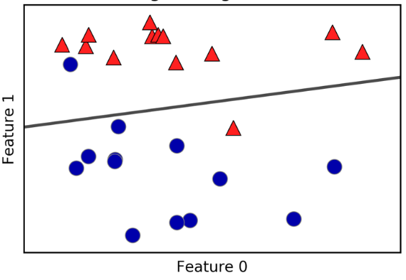
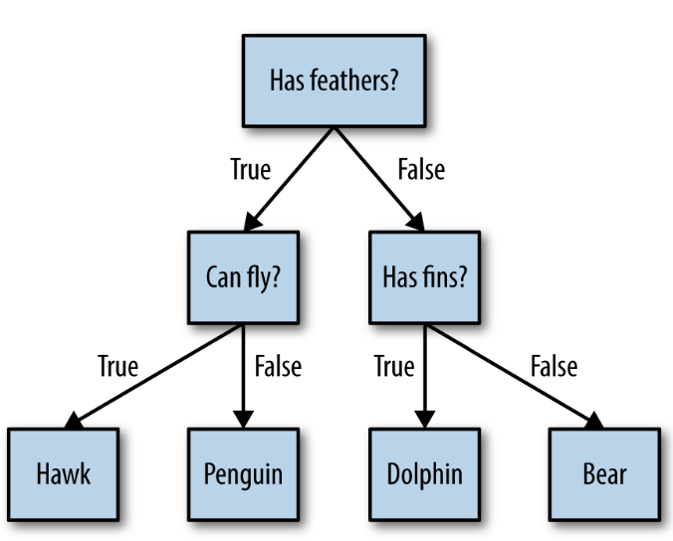
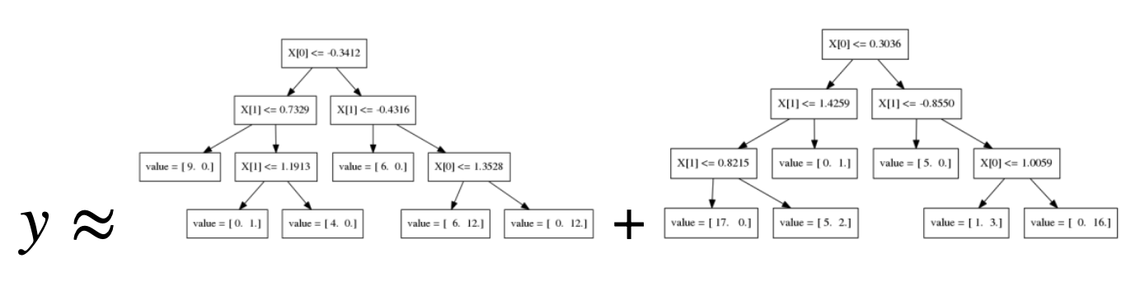
Models Considered
Logistic Regression
Random Forest
Gradient Boosting
Decision Making Process:
All three models generate probabilities of each row being class 1 or 0.
If probability is > 50% row is classed as 1 otherwise as 0.
Decision threshold can be changed from 50% to another value if necessary.
***Visualizations on this slide are from Intro to Machine Learning by Andreas Muller
***Model tuning is in appendix, shown next are results after tuning the models

Slide 7
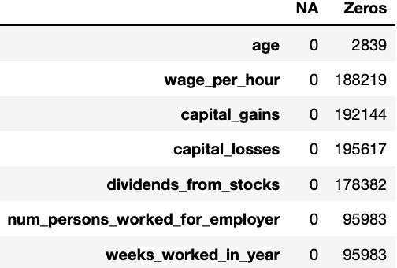
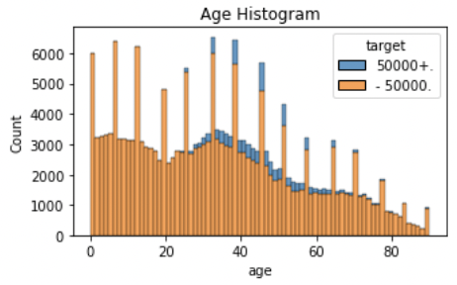
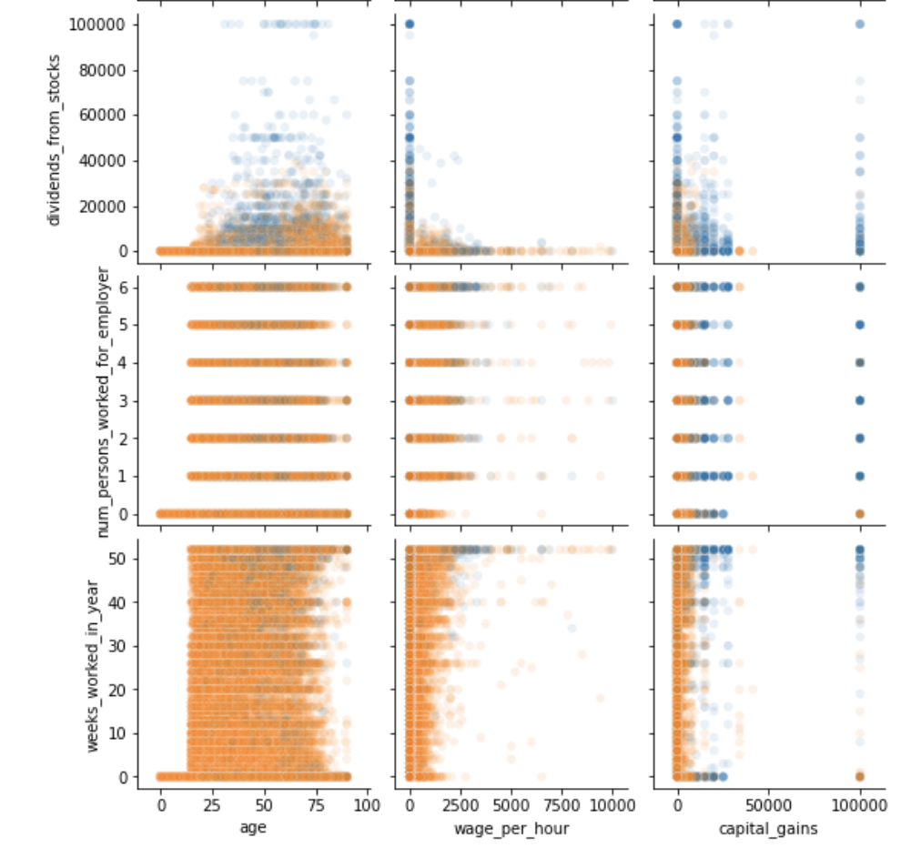
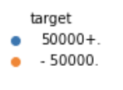
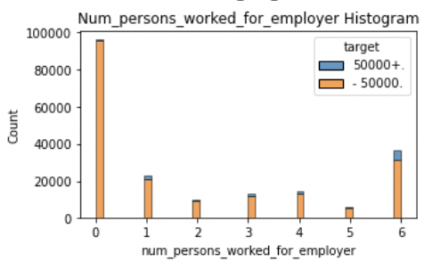
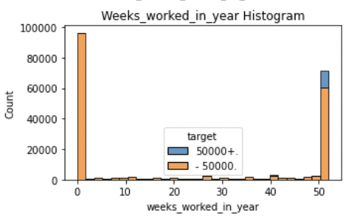
Continuous Features Overview
Statistical Summary:
Data set contains 7 continuous features (the rest were considered categorical).
No continuous features have missing values, but some have a substantial amount of 0’s.
Preliminary Evaluation
People between 23 and 60 are more likely to make over $50k.
Increased chance of making over $50k with increasing number of company employees
Full – time employees are more likely to make over $50k / year

Slide 8
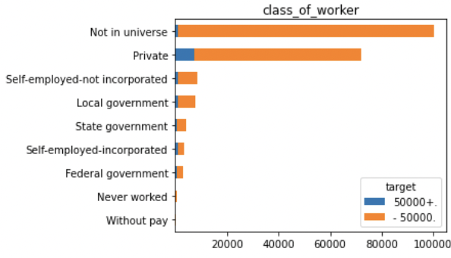
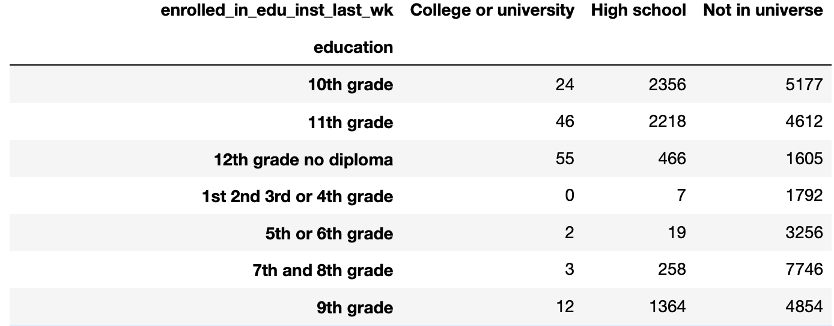
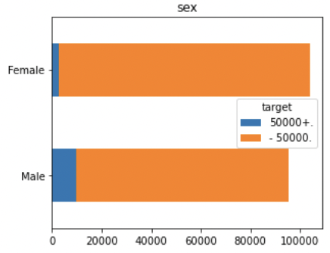
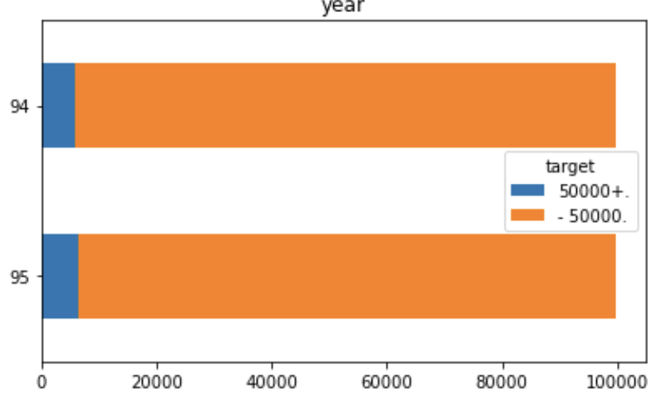
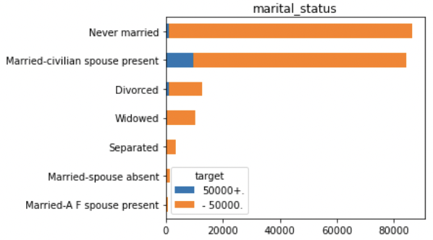
Categorical Features Overview
MEANINGFUL
NON - MEANINGFUL
People in private sector have a higher chance of making over $50k
“Enrolled in Education” and “Education” features contain similar information. Shouldn’t have correlated columns, need to pick one.
Males are more likely to make over $50k
”Year” feature has similar distribution for both years, might not be helpful in separating the data. Should have low importance.
Being married increases chances of making over $50k

Slide 9
Feature Selection

Slide 10
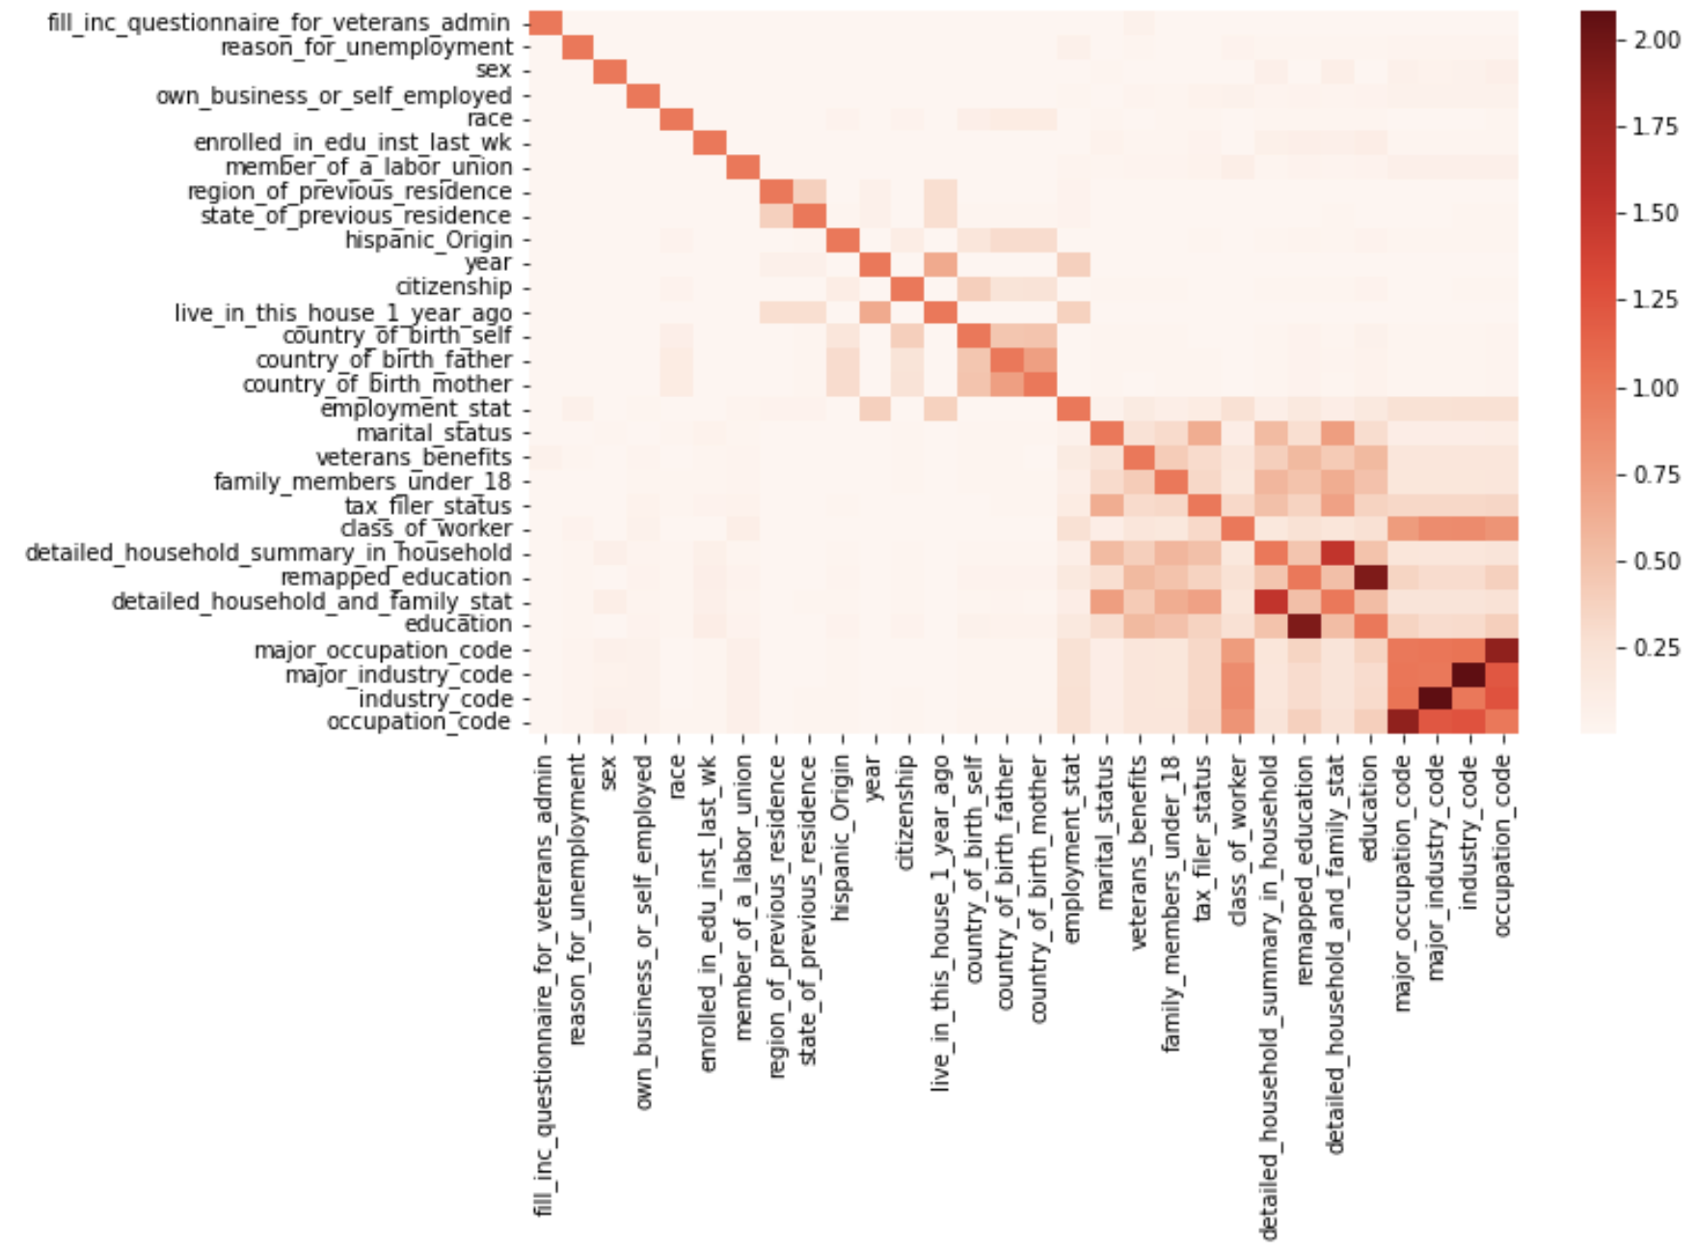
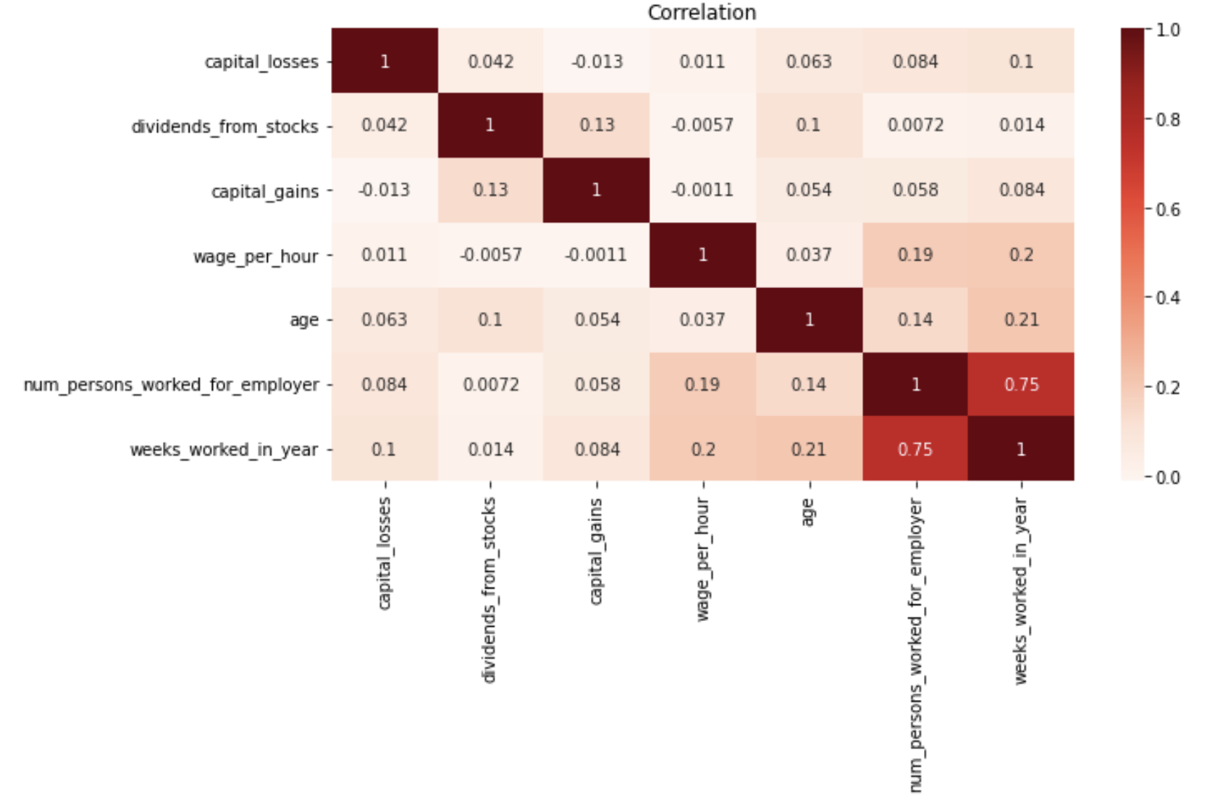
Correlations Between Features
Why not use all features?
Features that are supplying the model with similar information will split importance to the model and may appear less important.
Speed up the analysis and model building.
Easier to understand the model with less inputs.
Categorical Features Correlation
Continuous Features Correlation

Slide 11
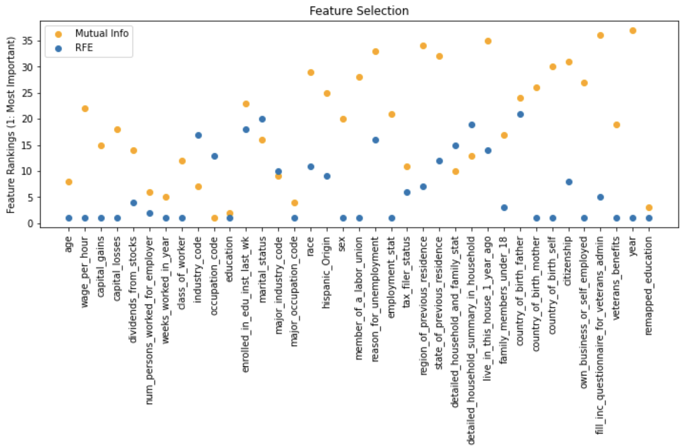
Feature Correlation to the Target
Eliminating Correlated Features:
Identify features that are correlated with each other.
Check correlation between features and target.
Out of 2 correlation metrics relying on Mutual Information more.
From correlated features drop the one that has lowest relationship to the target.
Excluded: major occupation and major industry codes, reason for unemployment, remapped education and enrollment status

Slide 12
Data Modeling

Slide 13
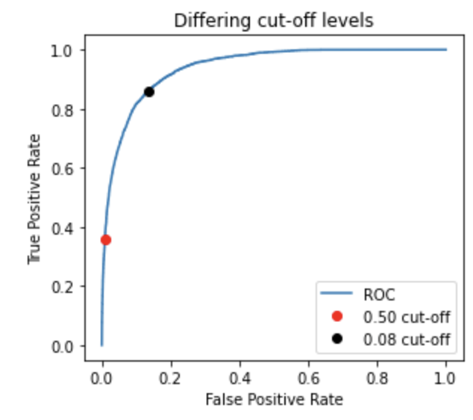
Model Scoring
Scoring Metrics:
Accuracy – % of predictions that are correct
Precision (PPV, positive predicted value) – % positive predictions that are actually positive
Recall (Sensitivity, true positive rate) – % positive records predicted as positive
False Positive Rate - % of negative records classified as positive
 | Predicted Negative | Predicted Positive
Negative Class | 4 | 3 | 7
Positive Class | 2 | 6 | 8
 | 6 | 9 | Totals (15)
Decision Threshold Tuning:
ROC – plot with Recall on y-axis and False Positive Rate on x-axis.
After the model is built and probabilities are estimated for each row.
ROC tests all the decision thresholds and calculates Recall and False Positive Rate.
ROC
Weight | Height | Target | Model Thresh
90 | 5 | Child | 0.30
130 | 5.4 | Child | 0.47
150 | 5.6 | Adult | 0.48
200 | 6.3 | Adult | 0.80

Slide 14
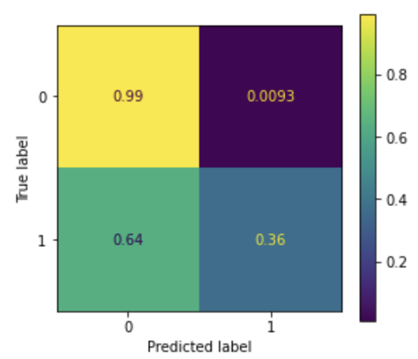
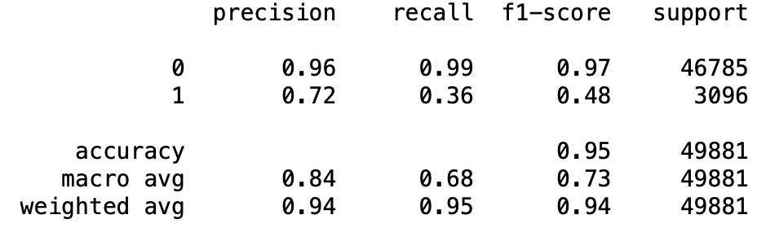
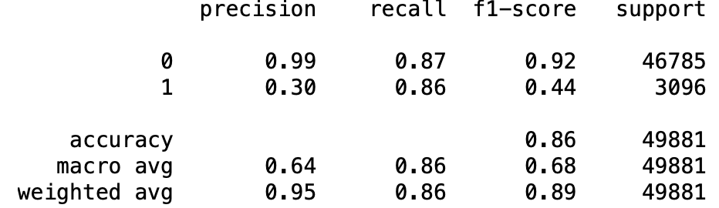
Logistic Regression Scores
Model Results (Validation Data):
At 50% cut-off model accuracy is 95% > 93%, model learned some patterns.
Recall for predicting people making over $50k is 36%.
Suggested decision threshold is 8%.
With updated threshold the model captures additional 50% of records making over $50k / year.
Updated threshold lowers accuracy to 86%.
Decision Threshold 50%
Decision Threshold 8%
Scoring Metrics:
Accuracy – % of predictions that are correct
Precision (PPV, positive predicted value) – % positive predictions that are actually positive
Recall (Sensitivity, true positive rate) – % positive records predicted as positive
False Positive Rate - % of negative records classified as positive

Slide 15
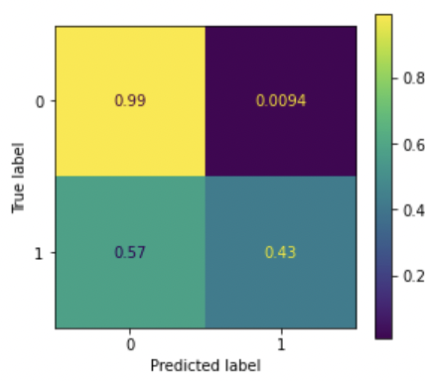
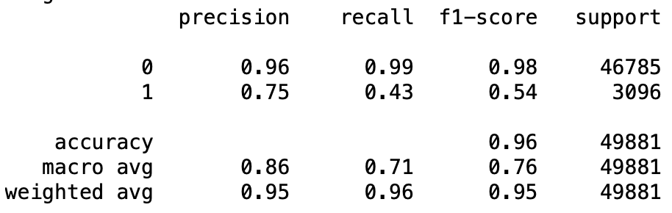
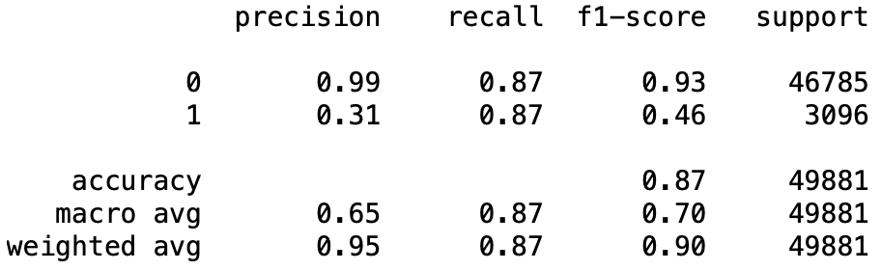
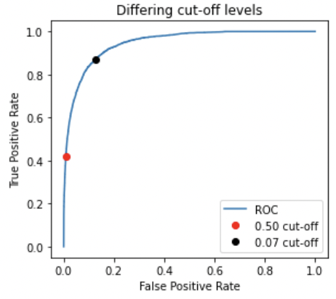
Random Forest Scores
Model Results (Validation Data):
At 50% cut-off model accuracy is 96% > 93%, model learned some patterns.
Recall for predicting people making over $50k is 43%.
Suggested decision threshold is 7%.
With updated threshold the model captures additional 44% of records making over $50k / year.
Updated threshold lowers accuracy to 87%.
Decision Threshold 50%
Decision Threshold 7%
Scoring Metrics:
Accuracy – % of predictions that are correct
Precision (PPV, positive predicted value) – % positive predictions that are actually positive
Recall (Sensitivity, true positive rate) – % positive records predicted as positive
False Positive Rate - % of negative records classified as positive

Slide 16
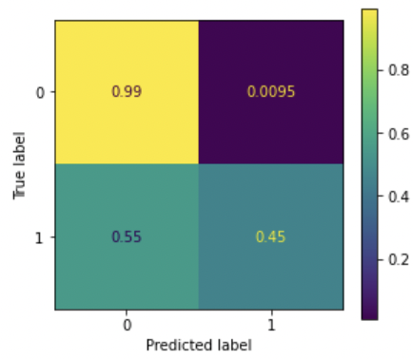
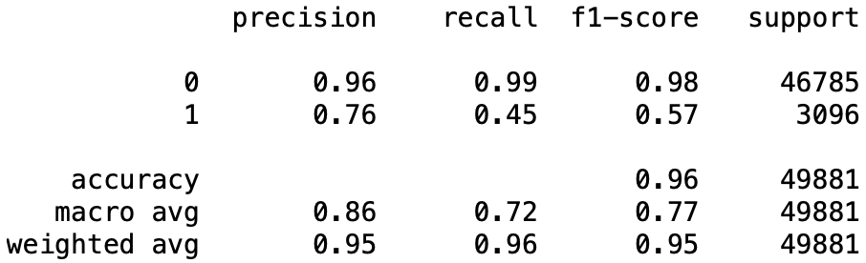
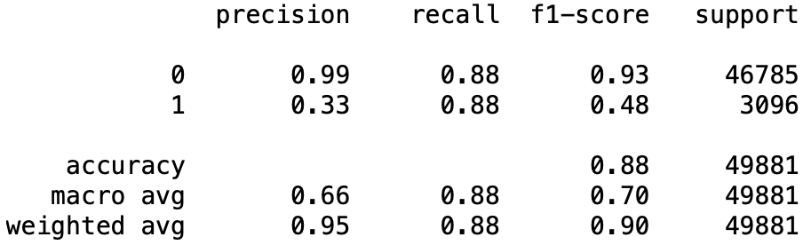
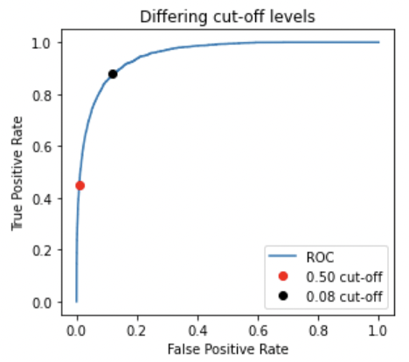
Gradient Boosting Scores
Model Results (Validation Data):
At 50% cut-off model accuracy is 96% > 93%, model learned some patterns.
Recall for predicting people making over $50k is 45%.
Suggested decision threshold is 8%.
With updated threshold the model captures additional 43% of records making over $50k / year.
Updated threshold lowers accuracy to 88%.
Decision Threshold 50%
Decision Threshold 8%
Scoring Metrics:
Accuracy – % of predictions that are correct
Precision (PPV, positive predicted value) – % positive predictions that are actually positive
Recall (Sensitivity, true positive rate) – % positive records predicted as positive
False Positive Rate - % of negative records classified as positive

Slide 17
Modeling Scoring Summary and Feature Importance
Scoring Summary (Test Scores in Appendix)
Logistic Regression
Random Forest
Gradient Boosting
Feature Importance Methods (used 0.5 decision threshold):
Permutation Importance
Each feature is selected one at a time and shuffled.
After it’s shuffled the model is scored and the decrease in score from the original model indicates the importance of that feature.
Partial Dependence
Each column is held to a constant value one at a time and the rows are predicted.
The final result is an average of all predictions. Partial dependence tells us how the model responds on average to changes in feature of interest.
Height | Weight | Adult
5.5 | 130 | Yes
4 | 85 | No
6 | 180 | Yes

Slide 18
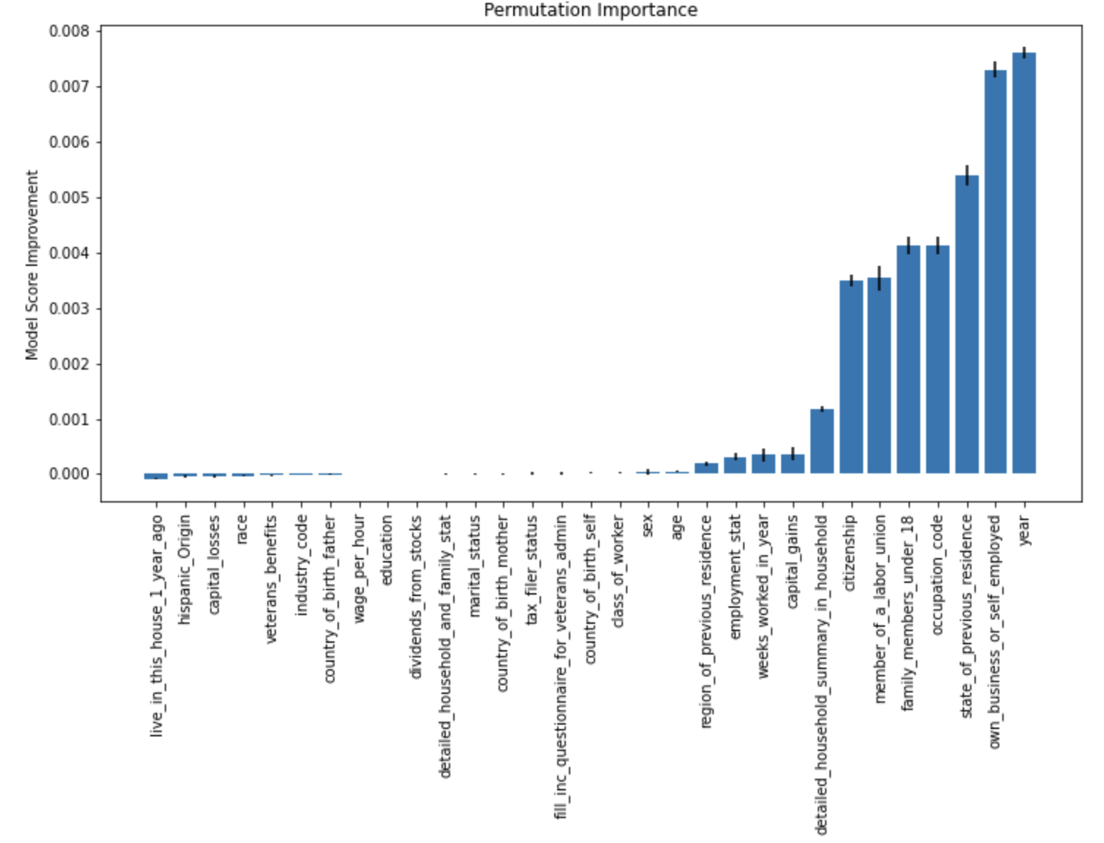
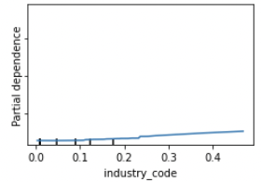
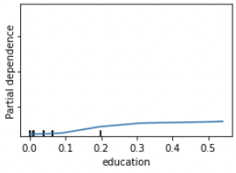
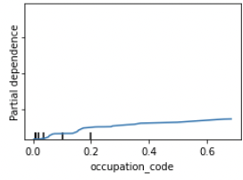
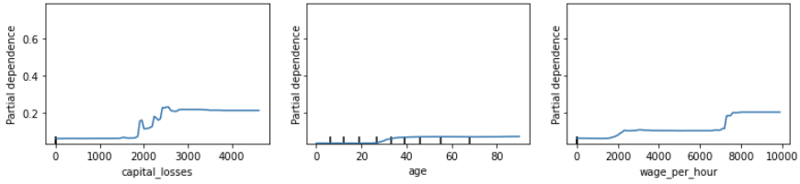
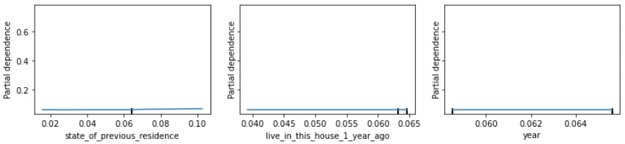
Random Forest Feature Importance
Permutation Importance
Permutation Importance ascribes importance to some features that were previously identified as uninformative (during data exploration).
Partial Dependence
Partial Dependence indicates that the model doesn’t respond to changes in “Year” feature. Data exploration confirms the results of Partial Dependence.
Relying mainly on Partial Dependence to determine feature importance

Slide 19
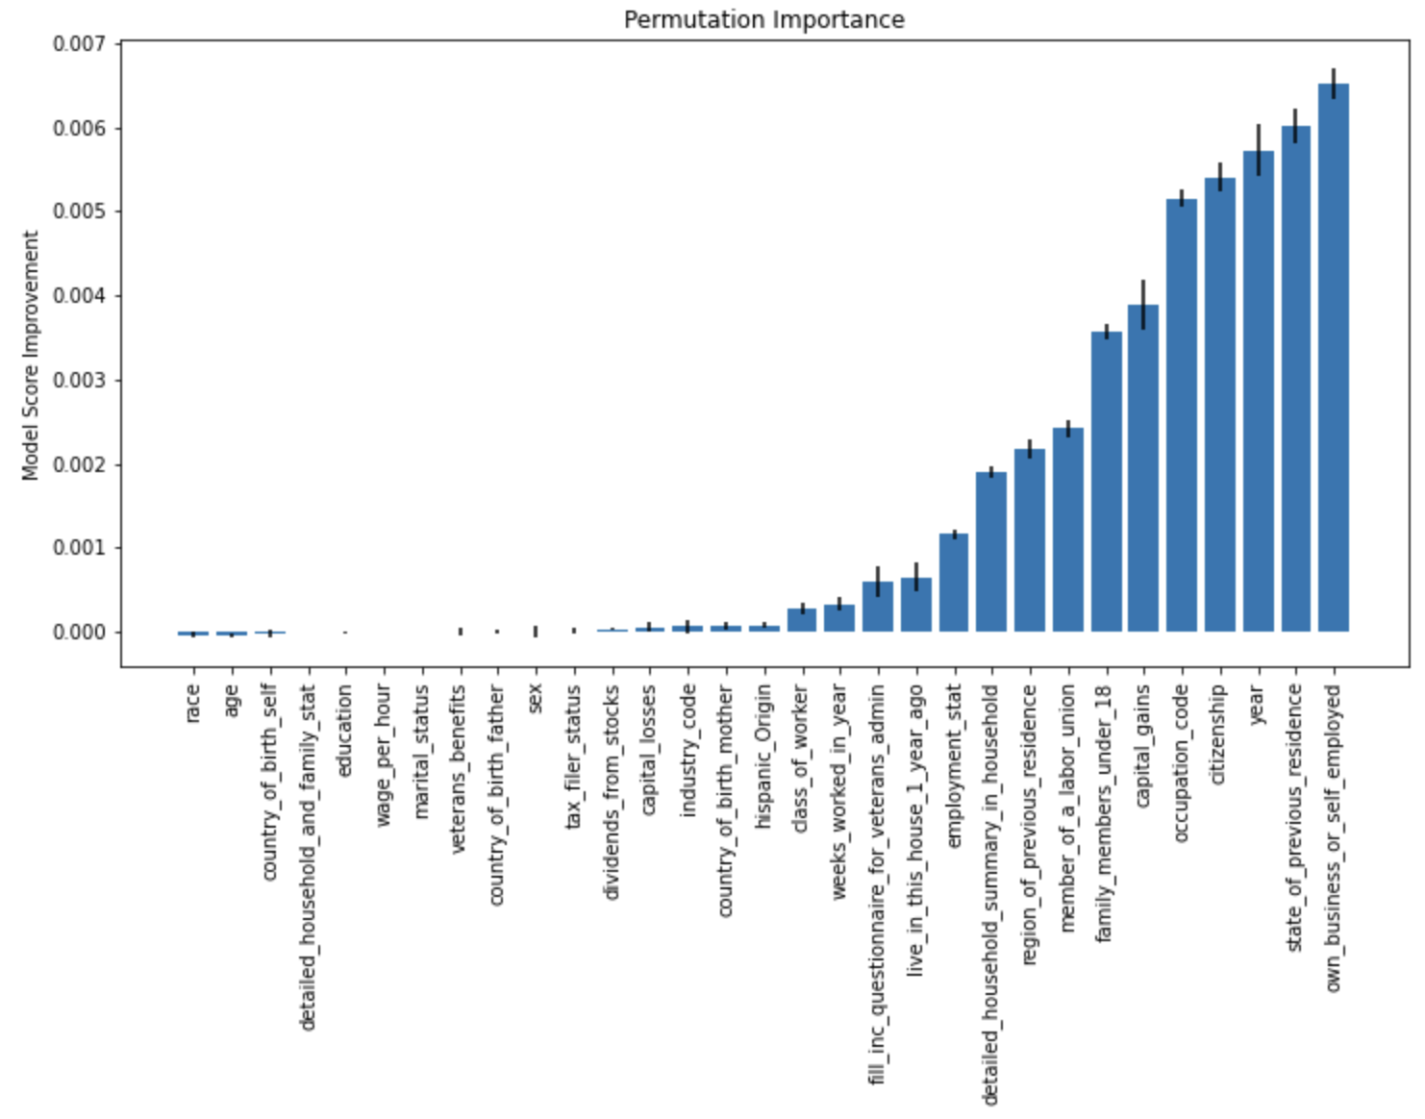
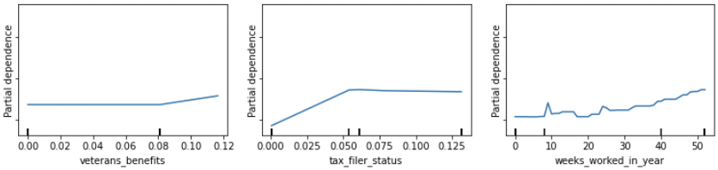
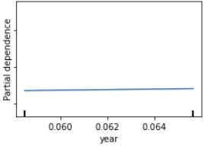
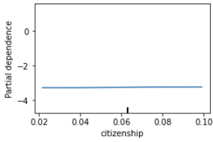
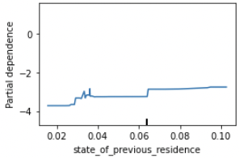
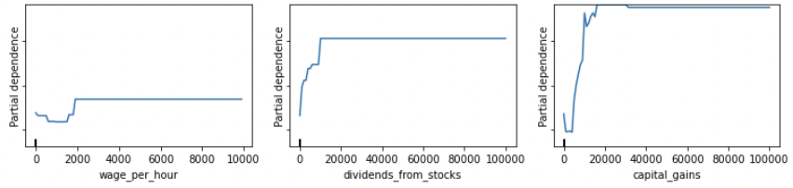
Gradient Boosting Feature Importance
Permutation Importance
Permutation Importance ascribes importance to some features that were previously identified as uninformative (during data exploration).
Partial Dependence
Partial Dependence indicates that the model doesn’t respond to changes in “Year” feature. Data exploration confirms the results of Partial Dependence.
Relying mainly on Partial Dependence to determine feature importance

Slide 20
Results / Improvements

Slide 21
Results
Characteristics under Gradient Boosting column have the biggest impact on determining if person’s income exceeds $50,000 / year.
Feature Importance Summary:
Permutation importance was omitted due to unexpected results.
Partial dependence was used as the main metric for feature importance.
Majority of the features between 2 models are the same. Features in blue are addition from Gradient Boosting.
Gradient Boosting is picked for final list of the most important characteristics.
Important Characteristics
Random Forest | Gradient Boosting
Capital Gains | Capital Gains
Dividents from Stocks | Dividends from Stocks
Wage per Hour | Wage per Hour
Age | Age
Capital Losses | Capital Losses
Weeks Worked in Year | Weeks Worked in Year
Education | Tax Filter Status
Industry Code | Education
Occupation Code | Detailed Household and Family Stats
 | Industry Code
 | Class of Worker
 | Occupation Code

Slide 22
Improvements
Improve feature selection, some correlated columns were still present.
Spend more time tuning the models. Random Forest could benefit from more estimators.
Use L1 regulation for Logistic Regression to exclude unimportant columns.
Expand Logistic Regression with polynomials, some features couldn’t be separated with a straight line.
Try PCA on numeric columns to remove correlation.
Improve mapping between tables in provided data set (if possible).

Slide 23
Appendix

Slide 24
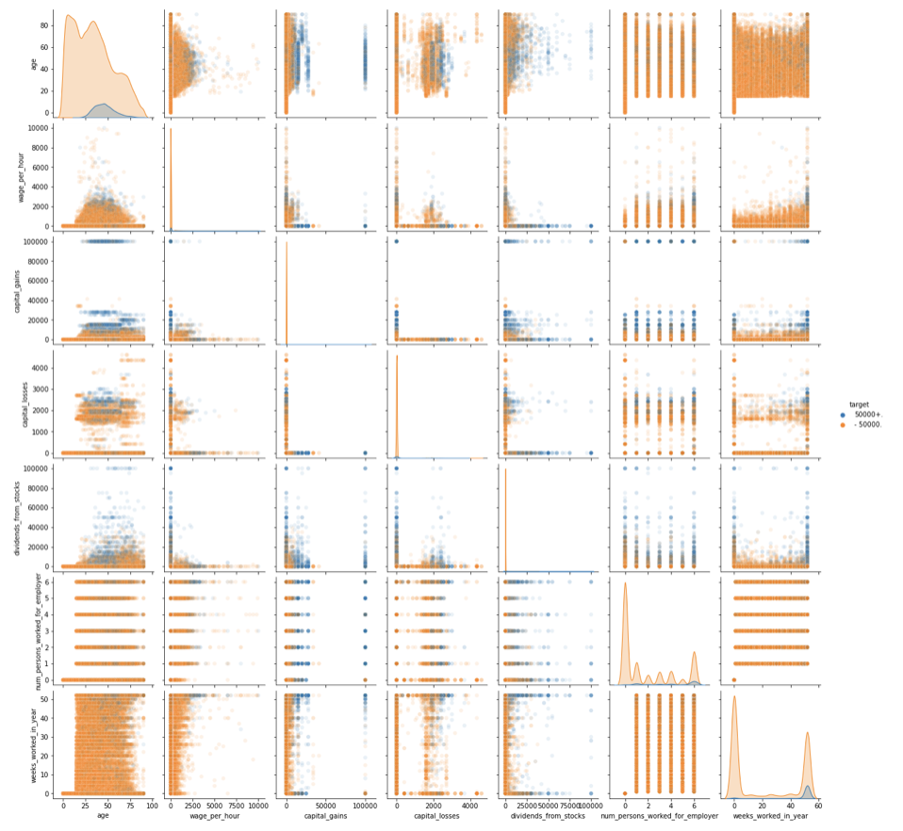
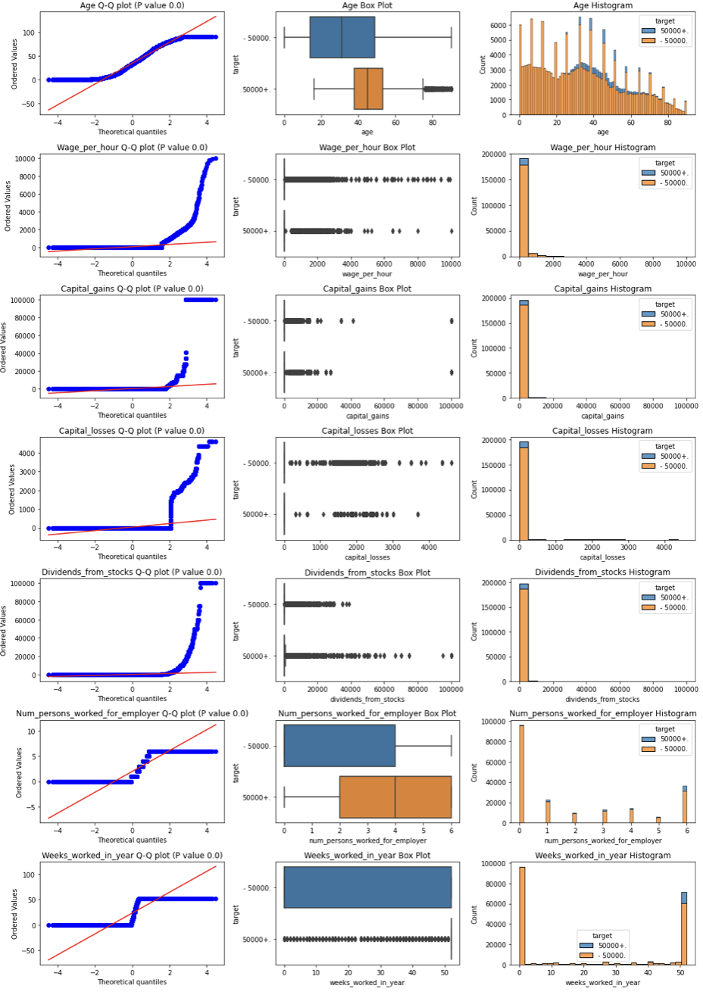
Continuous Column Analysis

Slide 25
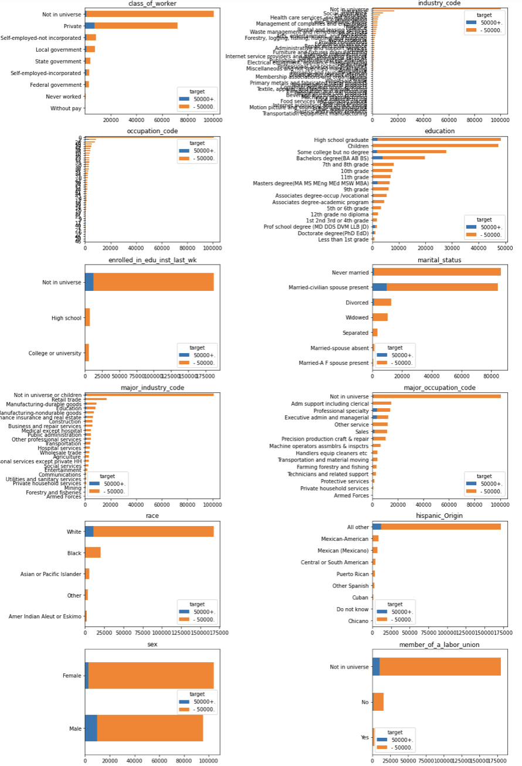
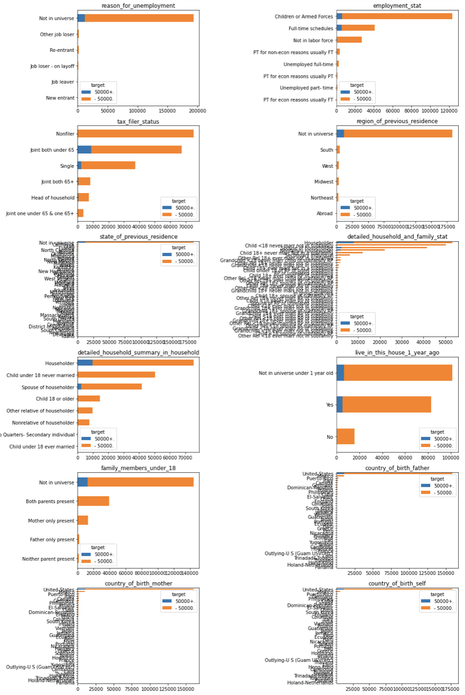
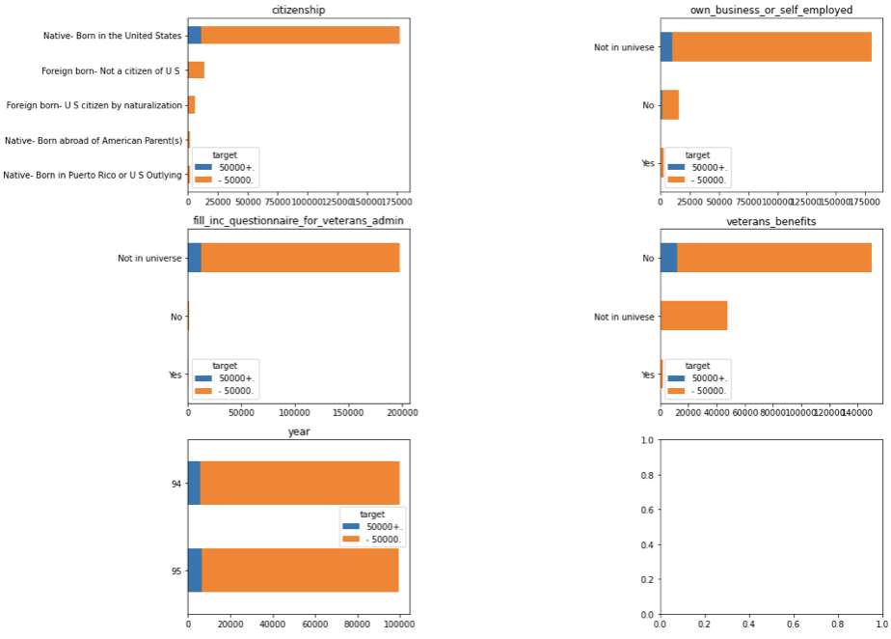
Categorical Column Analysis

Slide 26
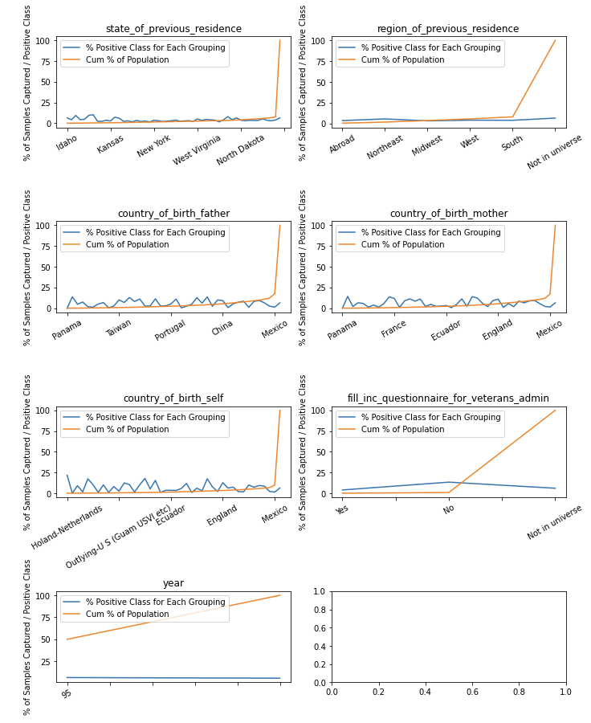
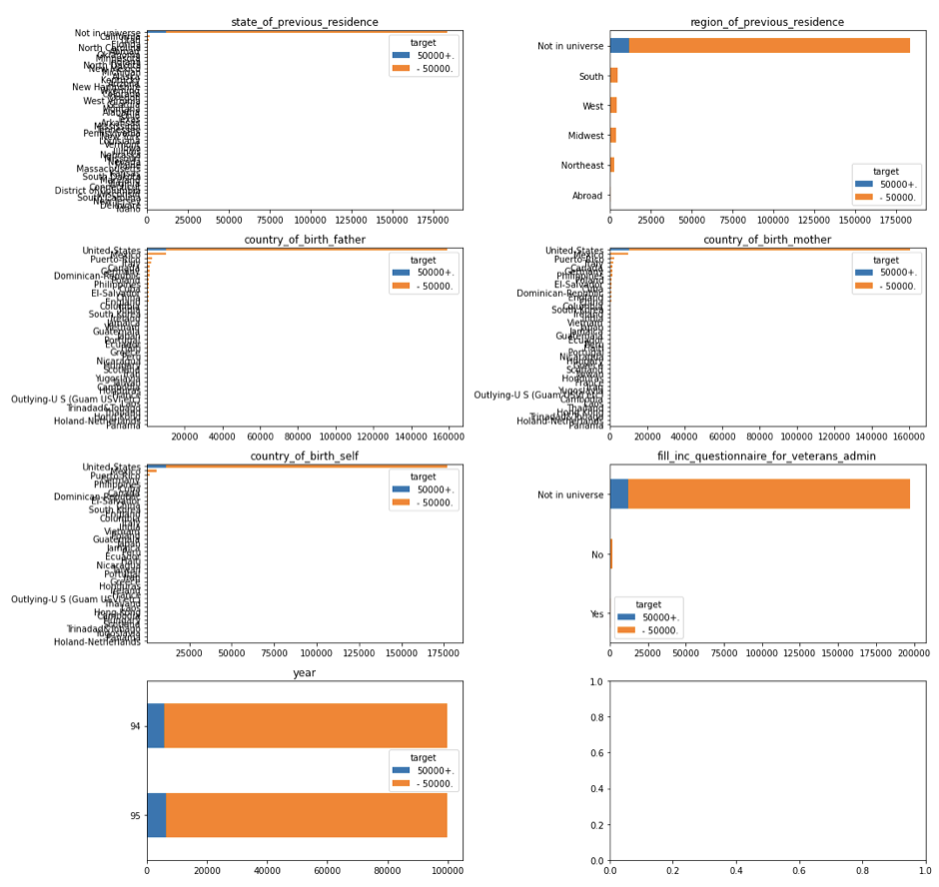
Categorical Similar / Uninformative Columns Analysis

Slide 27


Logistic Regression
Validation Scores
Algorithms Used
Column Transformer
Simple Imputer – on categorical values, fill with ‘NA’
Standard Scaler - continuous columns
One Hot Encoder – categorical with <10 unique values
Target Encoder – rest of categorical columns
Tuned the model with Multifidelity and Bayes methods. Picked the one that resulted in the best CV score.
Selected Parameters:
Penalty – ElasticNet
Solver – saga
C = 0.43
L1 ratio = 0.1
MF Tuning Heatmap

Slide 28



Random Forest
Test Scores
Algorithms Used
Column Transformer
Simple Imputer – on categorical values, fill with ‘NA’
Target Encoder – rest of categorical columns
Tuned the model for number of trees and max features selected utilizing warm start to accelerate computations.
Selected Parameters:
Estimators = 300
Max features = 25
Max depth = 10

Slide 29

Random Forest Partial Dependence

Slide 30


Gradient Boosting
Test Scores
Algorithms Used
Column Transformer
Simple Imputer – on categorical values, fill with ‘NA’
Target Encoder – rest of categorical columns
Tuned the model for number of iterations utilizing warm start to accelerate computations.
Selected Parameters:
Estimators = 300
Learning rate = 0.1
N iterations without change = 5
Max iterations = 600

Slide 31

Gradient Boosting Partial Dependence

